Slide 1


We’re doing
Eco-Schools!

Slide 2
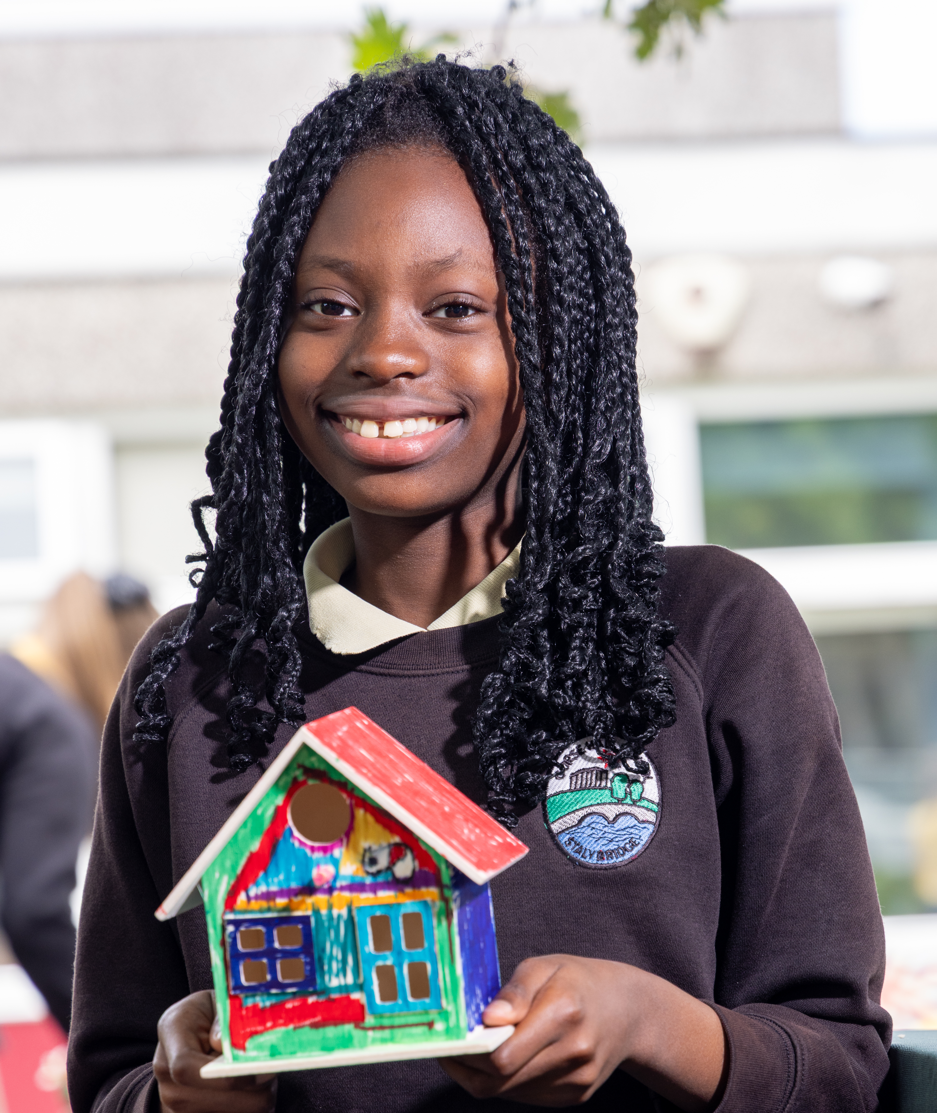
What is
Eco-Schools?
Eco-Schools is a simple, seven step framework designed to place young people, like us, in control of environmental actions and projects in our school, local community and beyond.

Slide 3
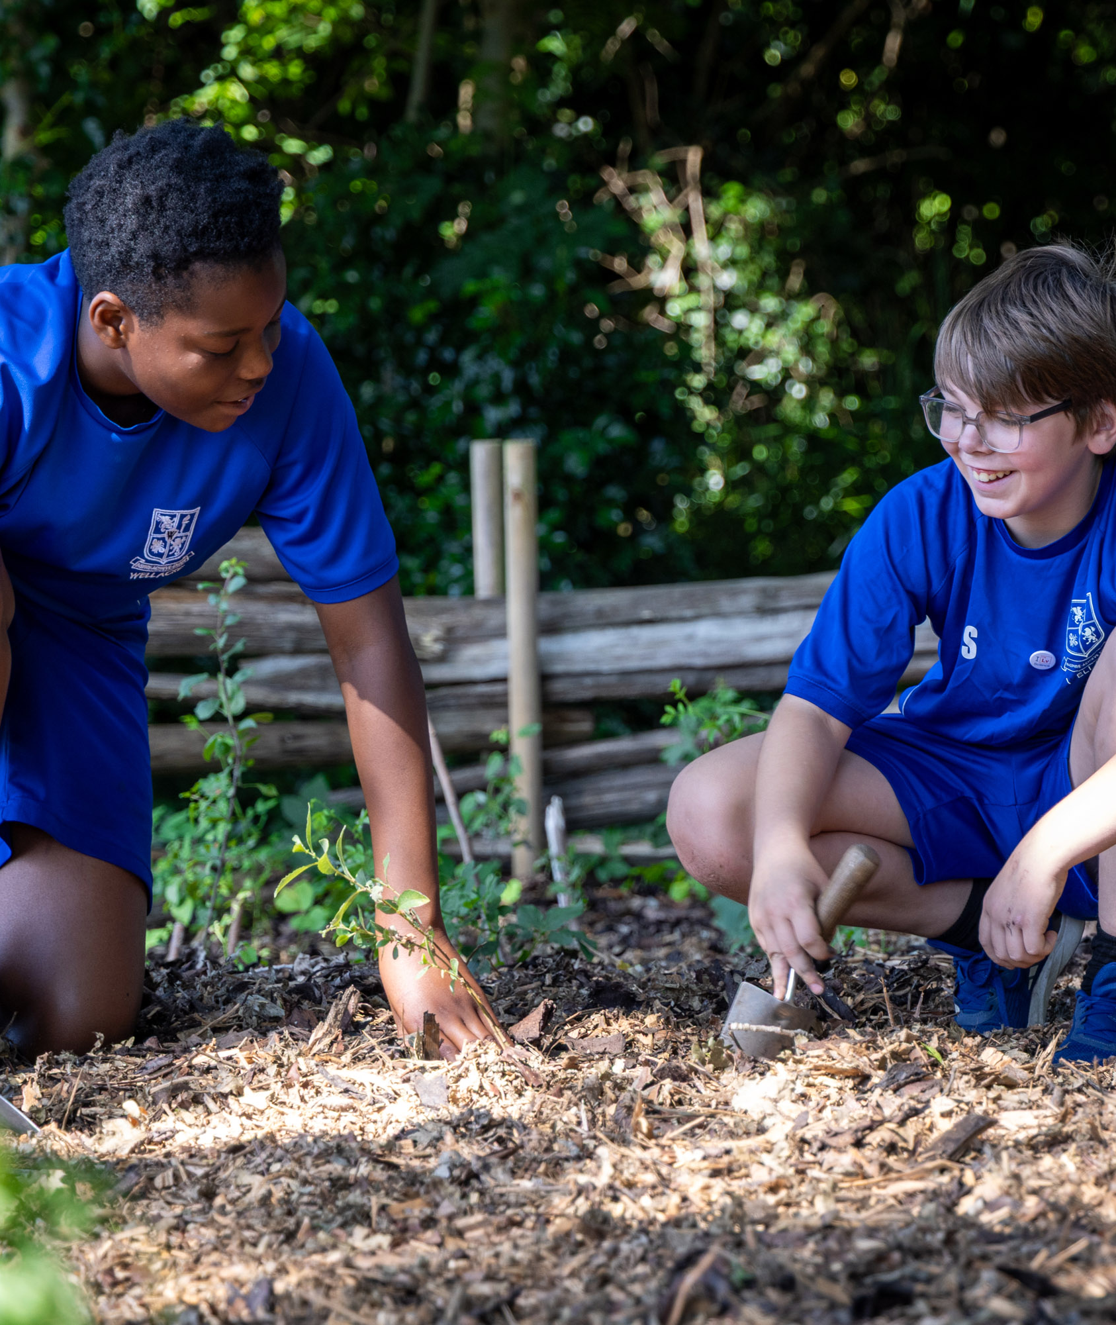
Why are young people taking action?
Climate change is happening now, and the impacts of climate change will only increase in the future. But young people don’t have to be bystanders. We can make a difference!

Slide 4





Across the year, we’ll deliver activities that connect to some of the 10 Eco-Schools topics
Biodiversity – Activities that support plant, insect, and animal life, across our site, local area, or globally.
Energy – Activities that increase the use of renewable energy and reduce day-to-day usage.
Global Citizenship - Activities that make our planet more peaceful, sustainable, and fair.
Healthy Living - Activities that boost the health and wellbeing of both people and planet.

Slide 5






Litter - Activities that empower young people to take responsibility for their local community and reduce litter.
Marine – Activities that protect and conserve water-based
eco-systems, such as rivers, canals, and beaches.
School Grounds - Activities that improve our setting for people, plants, animals, and insects.
Transport - Activities that promote sustainable travel, cutting carbon emissions.
Waste – Activities that promote the waste hierarchy and send as little waste as possible to landfill.
Water – Activities that preserve and appreciate our most important natural resource.

Slide 6
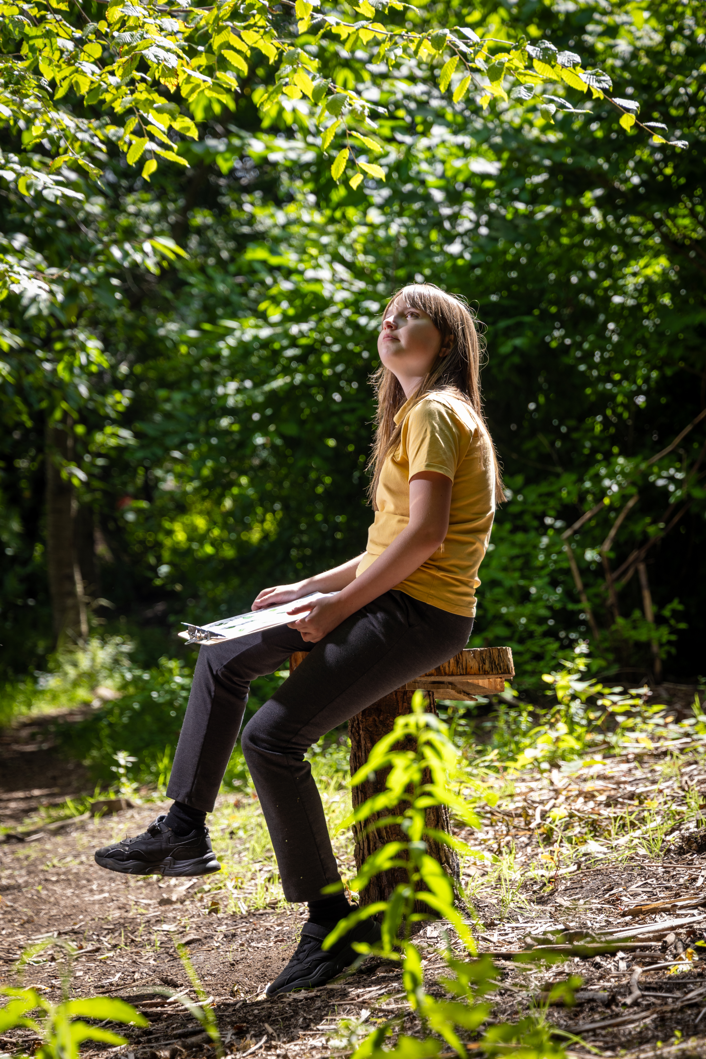

What next?
Keep an eye out for our activities in the near future.
If you would like to know more about Eco-Schools, or would like to join our school’s Eco-Committee, please contact:
(Insert details)

Slide 7
Find out more:
eco-schools.org.uk

